Slide 1
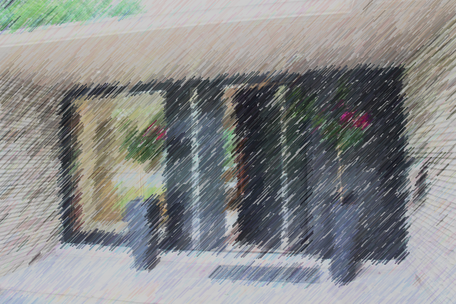
APP NAME
A PROJECT BY OTFD

Slide 2
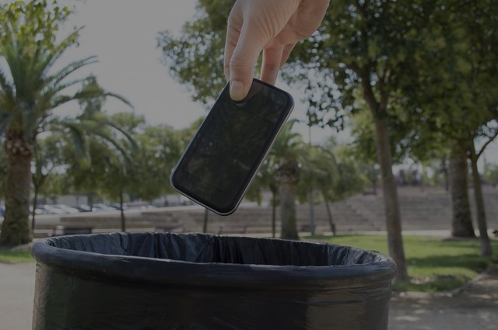
THE BEST WAY TO REUSE YOUR OLD SMARTPHONE
A PROJECT BY OTFD

Slide 3
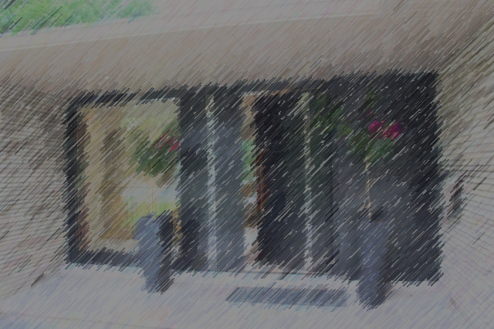
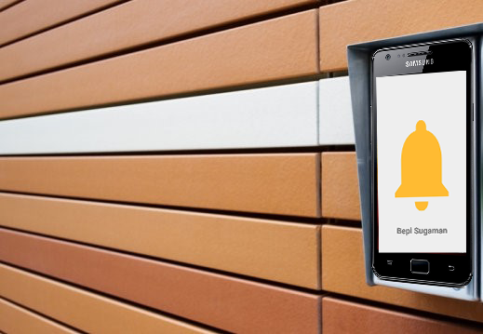
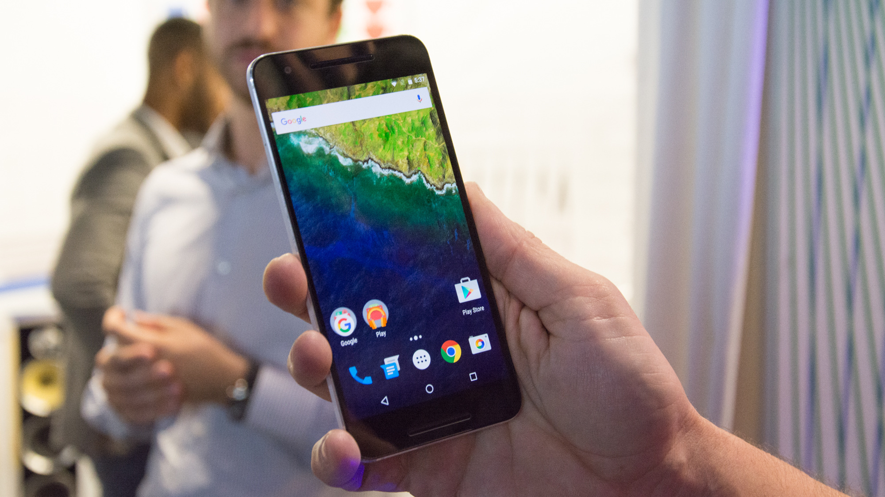
The old phone
is a bell
The new
is a manager
A PROJECT BY OTFD

Slide 4
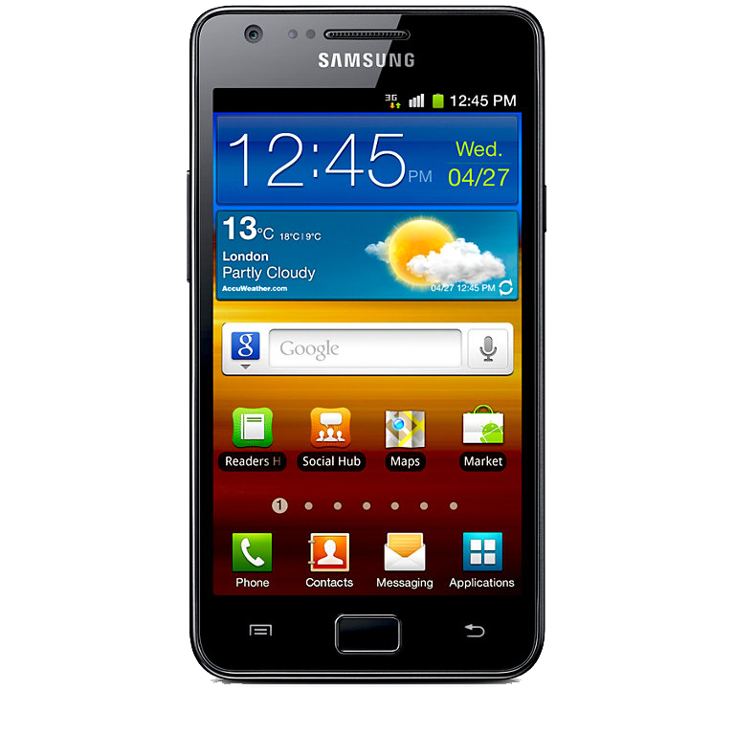
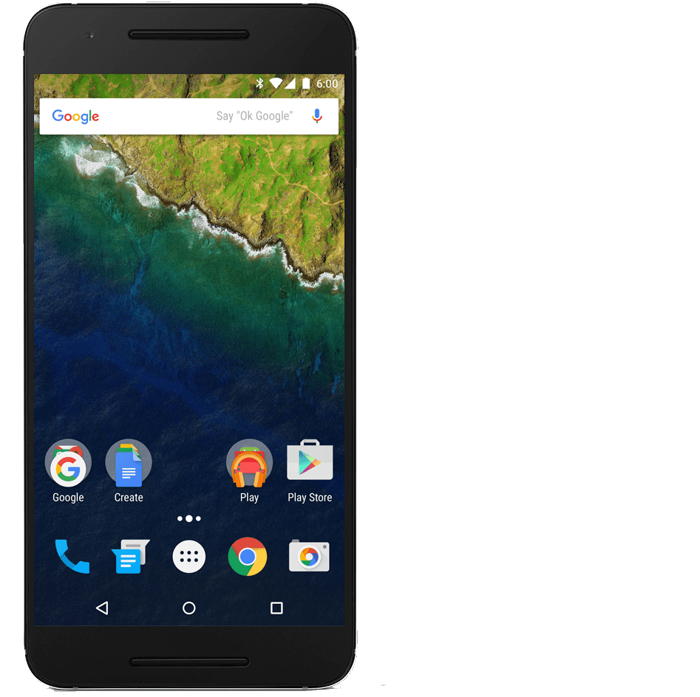


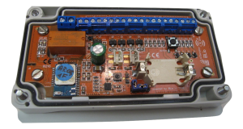
BLE Signal
A PROJECT BY OTFD

Slide 5
I/O signal
A PROJECT BY OTFD
A PROJECT BY OTFD

Slide 6
Demo time
A PROJECT BY OTFD

